Slide 1
CAPSTONE PROJECT 1
Customer churn prediction

Slide 2
OBJECTIVE OF PROJECT
Customer is very important to every industry.
Loss in customer is loss in profit of industry.
In Telecom industry customer churning is big problem. So it good to predict customers will going to churn or not. So specific action will be taken to stop customer from churning.
Building the machine learning model to predict which customers are going to churn is objective of project.

Slide 3
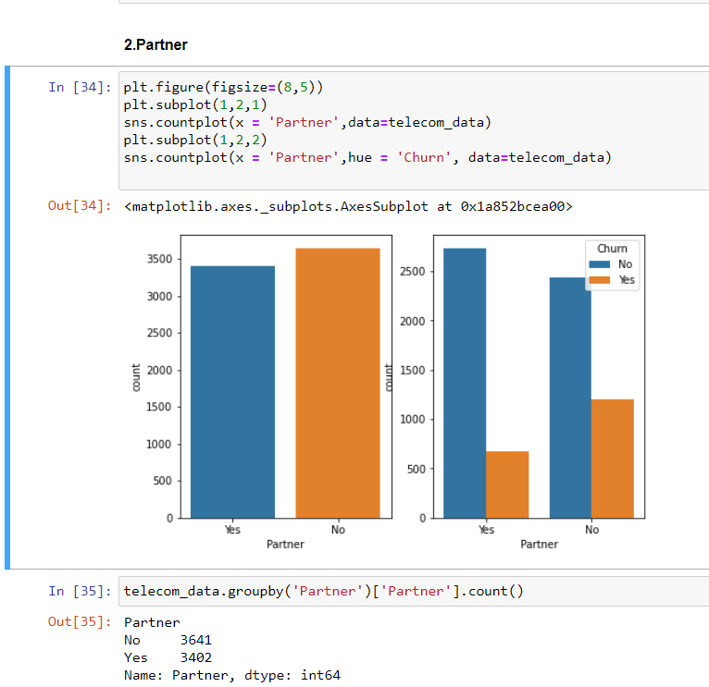
ANALYSIS OF DATA
Following important insights are found out from EDA analysis by using Python –
1. Average tenure of customers are 33 months.
2. Customers which are associated with company for long time are not like to churn.
3. Churning frequency is high for customers which have low tenure 0-9month.
4. Average monthly charges of customers is 65 & Avg. total charges are 2283.
5.Less no. of senior citizen customers are associated with company.
6. No. of senior citizen customers are not like to churn is high but
senior citizens who like to churn are in considerable no.
7. Churning frequency of customers who don’t have partner is high.

Slide 4
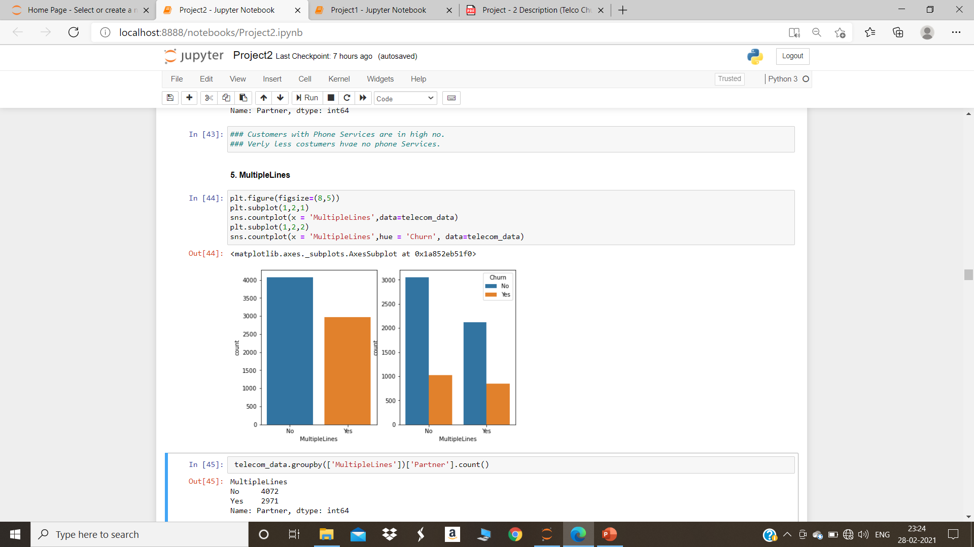
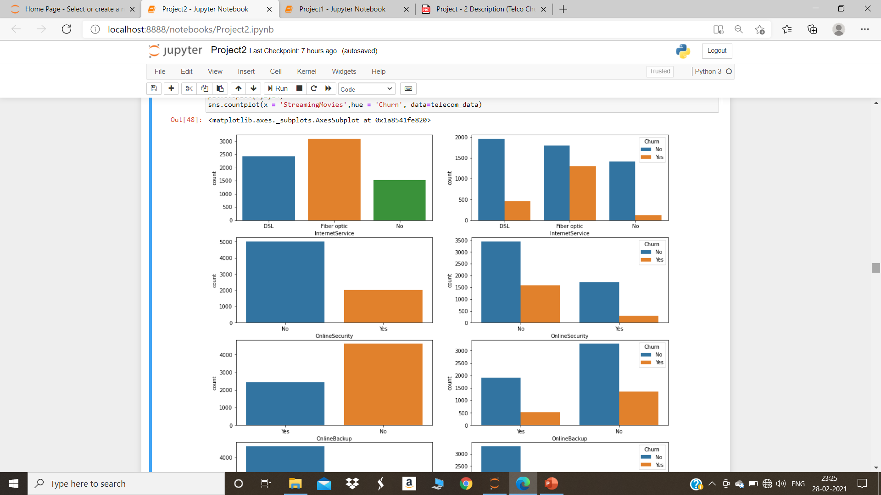
ANALYSIS OF DATA
8. Customers with multiple lines have churning frequency is high.
9. Customers which are using fiber optic internet service are churning highly.

Slide 5
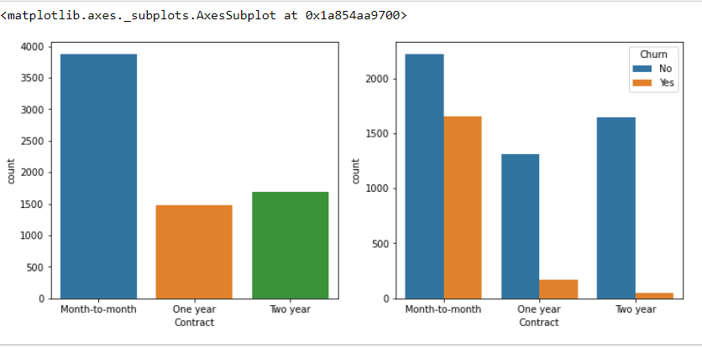
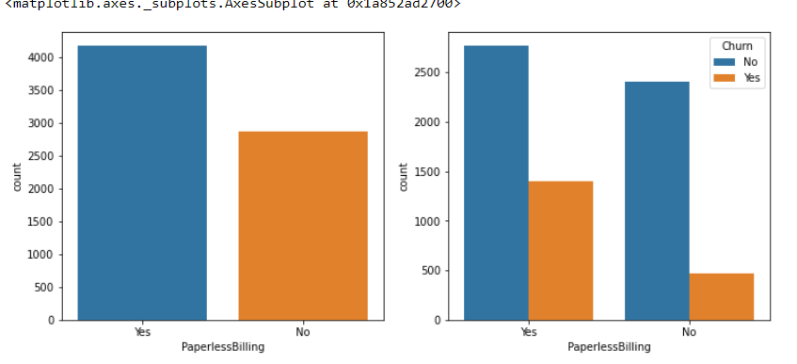
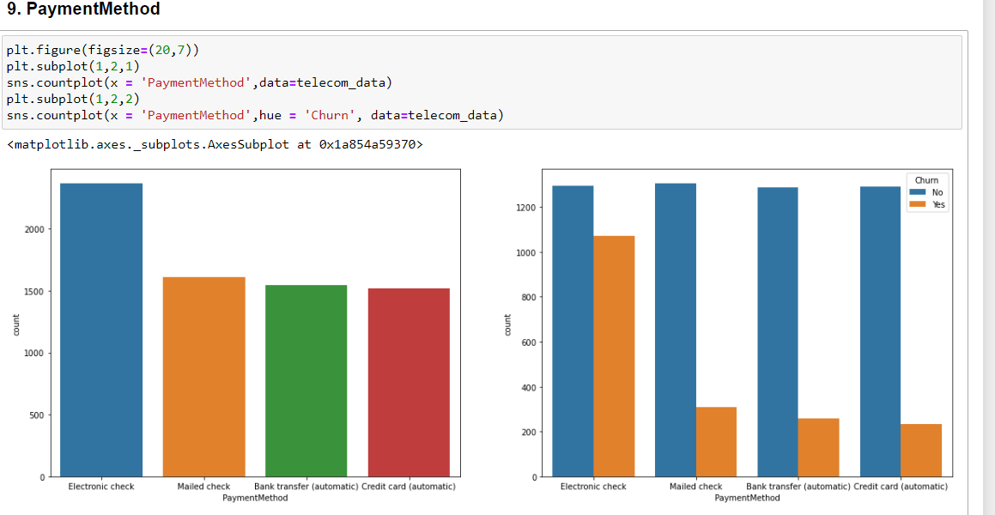
10.Churning frequency of customers which are using online security, device protection, tech support services is less compare to customers are not using it. 11.Max. no. of customers like to do month to month contract & churning frequency of these customers is high. 12.Churning frequency of customer is high who are doing paperless billing. 13. Churning frequency of customer is high who are doing payment to Electronic Check.

Slide 6
Assumption considered while selecting model
Distribution of data.
No. of columns & rows
Outliers in data.
Selection of variables which are contributing in prediction of customer will churn or not

Slide 7
MODEL USED
89.0
Concrete Compressive Strength is categorical Target variable .
So following models are build to predict Customer is like to churn or not –
1. Logistic Regression.
2. Decision Tree Classifier.
3. Random Forest Classifier.
On the basis of Recall value 0.53 Logistic Regression is good for prediction.

Slide 8
